Slide 1

Big MOUNTAIN RESORT
TICKET PRICING MODEL

Slide 2

Problem IDENTIFICATION
Big Mountain Resort is not capitalizing on its facilities as much as it could
Steps to Consider:
Implement a more data-driven business strategy
Develop a new ticket pricing model
Evaluate operational changes and their impact on ticket revenue
Notes:
© Copyright Showeet.com – Free PowerPoint Templates

Slide 3
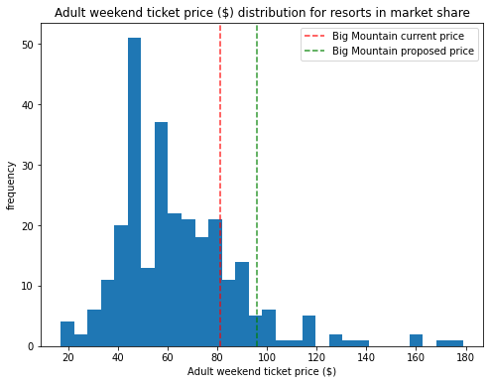
Recommendations and Key Findings
The model supports the increase of ticket prices from $81 up to $94.22.
Scenarios for Operational Changes
Shut down up to 10 of the least used runs
Increase vertical drop by 150 ft.

Slide 4
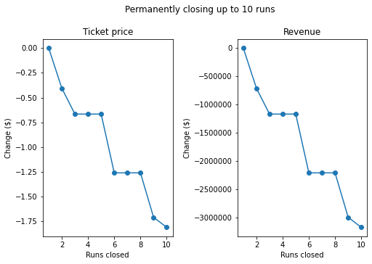
Modeling Results And aNalysis
Scenario 1: Shut down up to 10 of the least used runs
Closing 1 run has no impact on price.
Closing 2 and 3 runs successively reduces support for ticket price and reduces estimated revenue by approximately $710,045 and $1,166,667.
The shutdown of the consecutive 4th and 5th runs results in no further loss past that assessed by the closure of the 3rd run

Slide 5
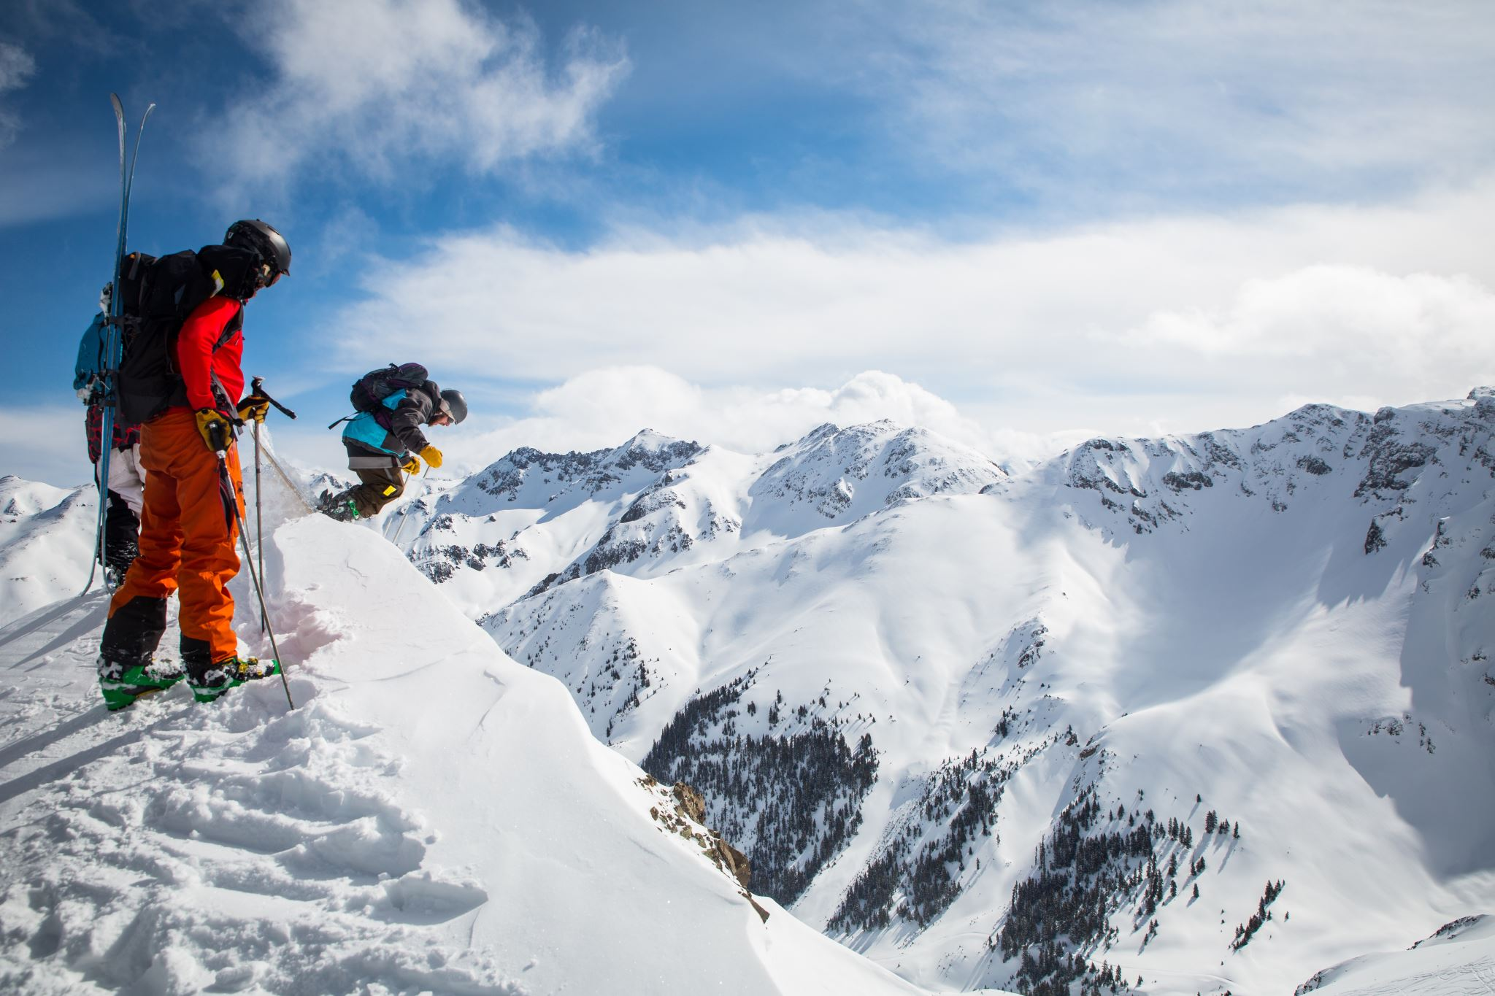
Modeling Results And aNalysis
Scenario 2: Increase vertical drop by 150 ft by adding a run and addition chair lift
Expect an increase in revenue of $3,474,638
Additional chair lift operating costs estimated at $1,540,000
Expected profit of nearly $2M

Slide 6
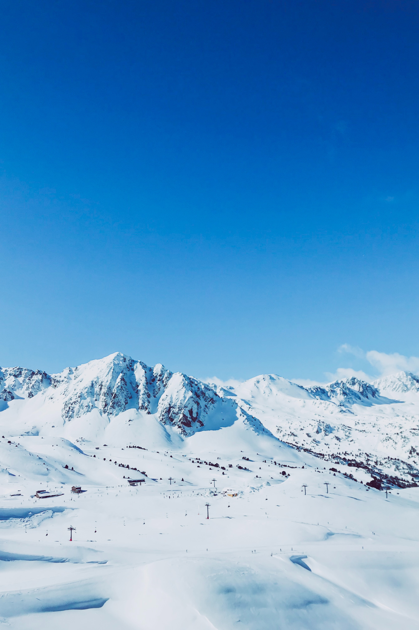
Modeling Results And aNalysis
Most relevant features justifying higher ticket price
The number of fast four person chairs
Count of the number of runs on the resort
Total area covered by snow making machines in acres

Slide 7

Summary and Conclusion
Increase adult ticket price to $94.22
Shut down least used run
The shutdown of the consecutive 4th and 5th runs results in no further loss past that assessed by the closure of the 3rd run
Notes:
© Copyright Showeet.com – Free PowerPoint Templates

